Slide 1
Lesi Parking
To make parking easy, fast, and stress-free!

Slide 2






OUR TEAM
DUMINDU SHANILKA
GAYAN DANANJAYA
UGC0122033
UGC0122020
VINDI PERERA
UGC0122025

Slide 3
TABLE OF CONTENTS
01
02
03
04
05
INTRODUCTION
AIM
OBJECTIVES
Revolutionizing parking with ease and efficiency.
Simplifying parking for urban commuters
Real-time updates, automation, eco-friendly options
SCOPE OF THE PROJECT
LIMITATIONS AND ROADBLOCKS
Comprehensive platform for parking management
Overcoming challenges to deliver a reliable, user-friendly parking solution.

Slide 4
TABLE OF CONTENTS
06
07
08
09
10
11
FUNCTIONAL REQUIREMENTS
NON-FUNCTIONAL REQUIREMENTS
SYSTEM ARCHITECTURE
Core features for booking and access
Focus on reliability and user experience
Structured framework connecting all users.
TESTING PROCESS
TECHNICAL EXPOSURE
DIAGRAMS
Use case diagram, Class diagram and ER diagram
Ensuring flawless experience through testing
Modern tools for enhanced parking management

Slide 5
INTRODUCTION
01
With rising vehicle numbers in Sri Lanka’s urban areas, parking has become challenging, causing congestion and delays. Our Parking Management System provides a digital platform for users to find, reserve, and pay for parking, utilizing real-time tracking and payments to streamline the process and promote sustainable urban mobility.

Slide 6
AIM
02
The primary goal of the Parking Management System is to create a scalable and efficient solution by using Lesi Parking System.

Slide 7
OBJECTIVES
03
Real-Time Updates and Space Monitoring
Automated Entry and Exit Management
User Account and Loyalty Features
Responsive Webpages
Advance Booking and Reservations

Slide 8
SCOPE OF THE PROJECT
Deliverables: Platform Features: User-friendly system with registration, parking search, real-time updates, and notifications. User Roles: Drivers, Parking Facility Owners, and Administrators with distinct functions.
04

Slide 9
LIMITATIONS AND ROADBLOCKS
05
Time limitation
Lack of knowledge on the technologies
Changing requirements

Slide 10
FUNCTIONAL REQUIREMENTS
06
Drivers (Users)
Search Parking Spots
View Parking Details
Make Reservations
Parking Facility Owners
Sign Up and Registration
Provide land
Administrators
User Management
Monitor Reservations and Transactions
Content Management

Slide 11
NON-FUNCTIONAL REQUIREMENTS
07
Performance
Scalability
Reliability and Availability
Delivers fast responses and smooth operation
Supports seamless growth and new features.
Ensures continuous access with minimal downtime
Usability
Security
Offers an intuitive, easy-to-use interface
Safeguards user data and privacy.

Slide 12
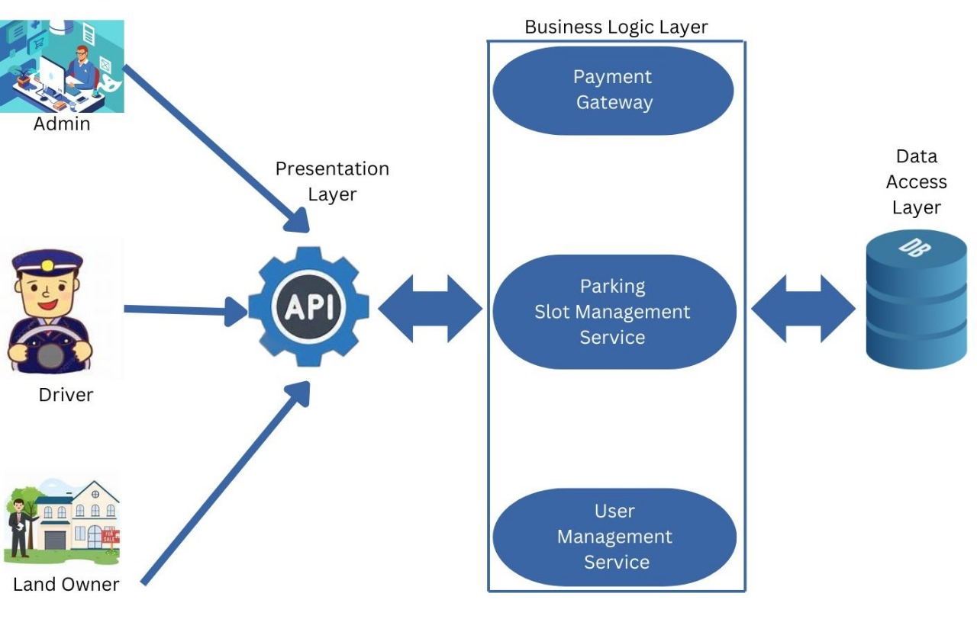
08
SYSTEM ARCHITECTURE

Slide 13
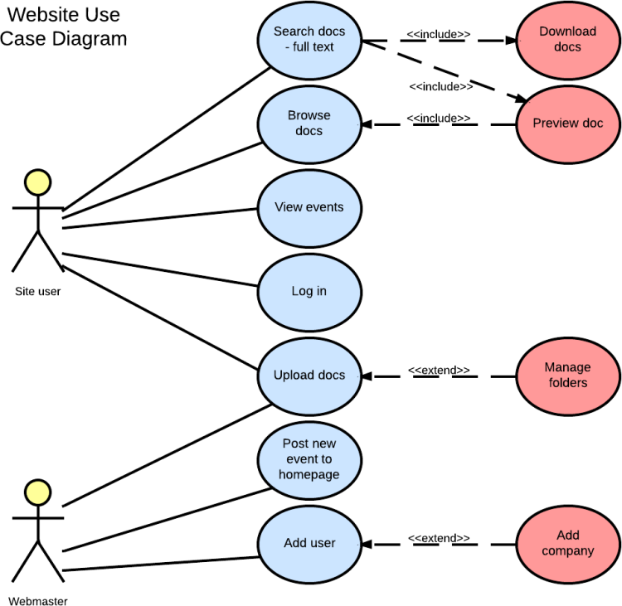
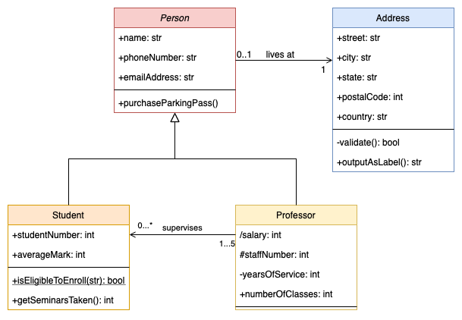
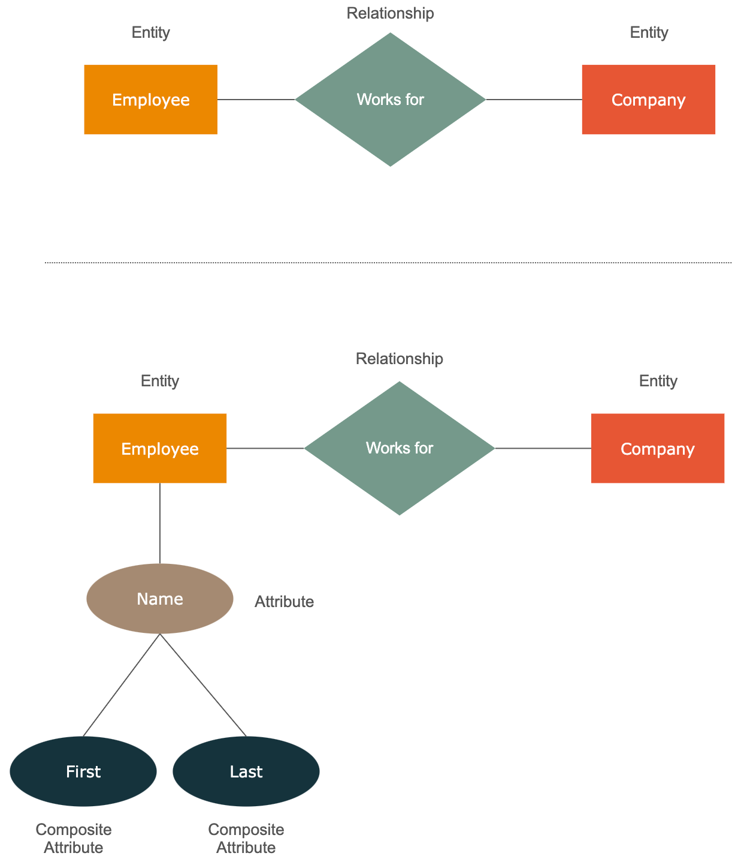
DIAGRAMS
09
Use-Case Diagram
Class Diagram
ER Diagram
Mapping out user interactions to bring clarity and efficiency to the parking journey
Organizing the elements that make up our system to bring the concept into structure.
A visual framework linking all essential data points to streamline system interactions

Slide 14
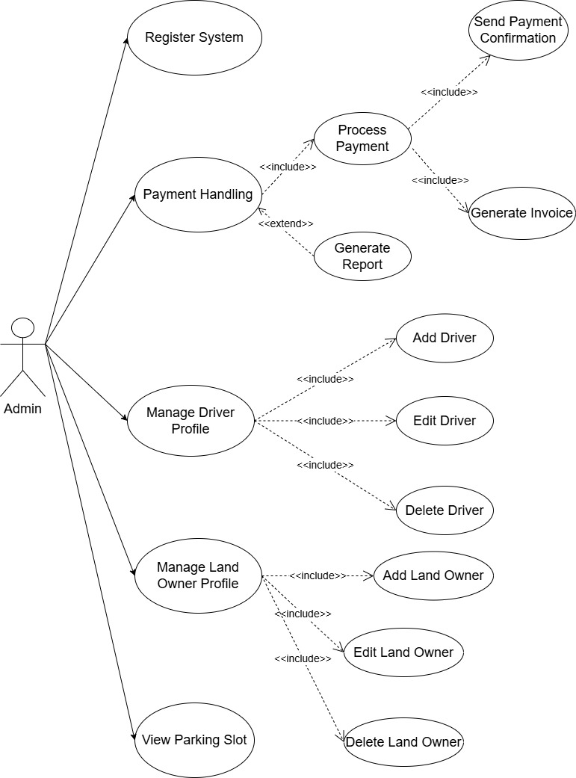
USE CASE DIAGRAM
ADMIN

Slide 15
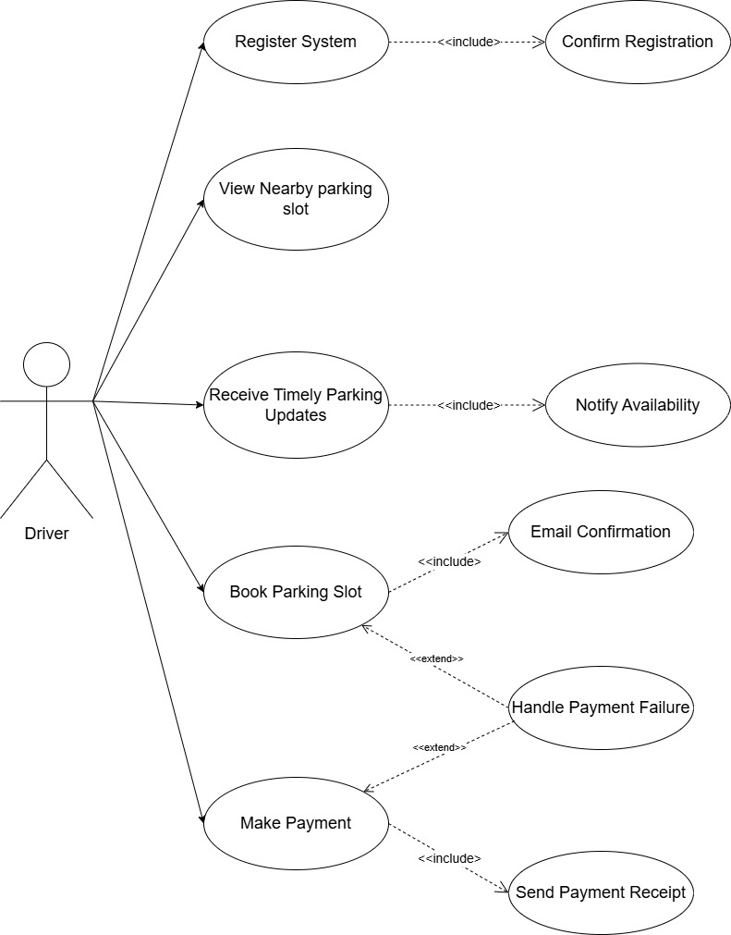
USE CASE DIAGRAM
DRIVER

Slide 16
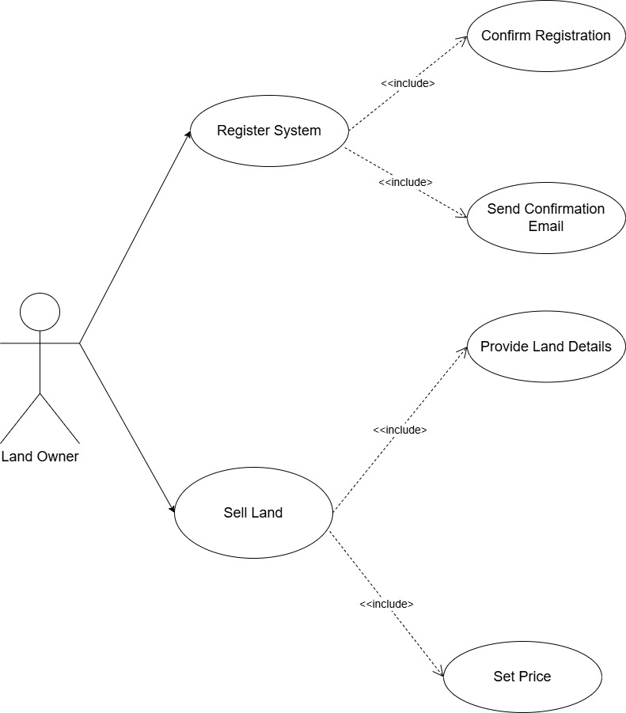
USE CASE DIAGRAM
LAND OWNER

Slide 17
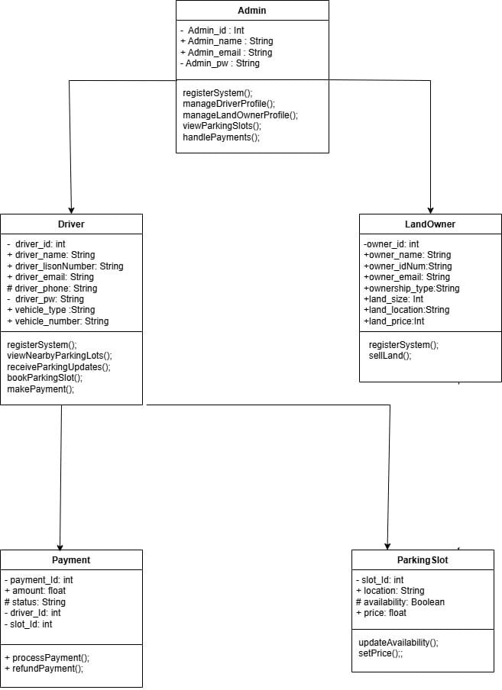
CLASS DIAGRAM

Slide 18
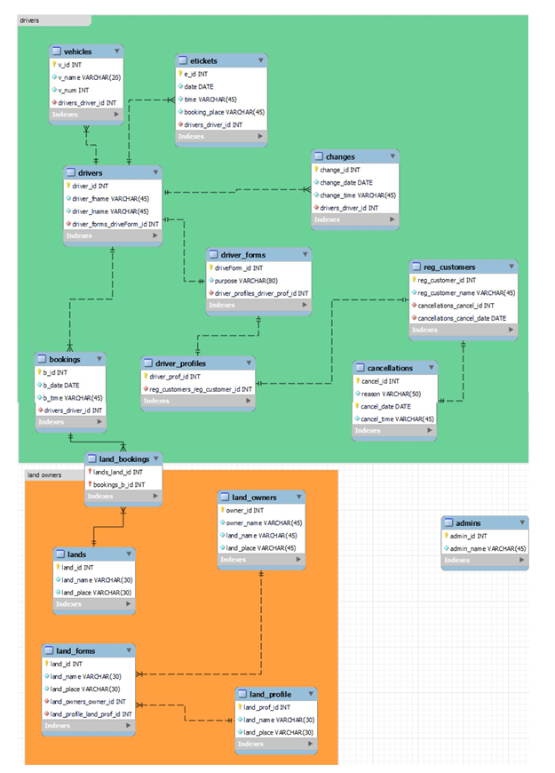
ER DIAGRAM

Slide 19
TESTING PROCESS
10
Carried out unit testing on each component manually
Integration testing after integrating components.
Regression testing to ensure existing features work after updates.

Slide 20






TECHNICAL EXPOSURE
11

Slide 21
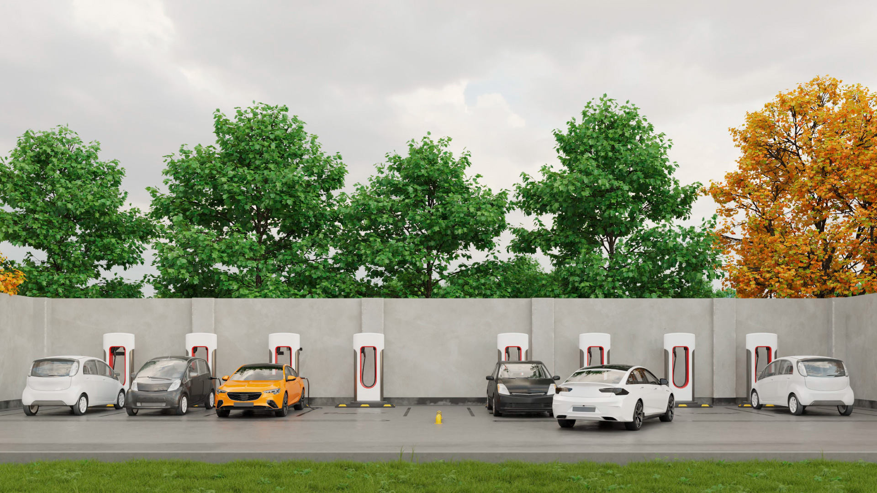
THANK YOU !

Slide 22
QUESTIONS ?

